Slide 1
Data 607 Final Project
Zhi ying chen

Slide 2
Problem 1.
5 points
P(X>x | X>y) = 0.7920165
The probability of X greater than median value of X given that X is greater than first quartile of y is 0.79.
b. P(X>x, Y>y) = 0.3765
The probability of X greater than median value of X
and Y is greater than first quartile of y is 0.3765.
c. P(X<x | X>y) = 0.2079835
The probability of X less than median value of X given
that X is greater than first quartile of y is 0.21.

Slide 3
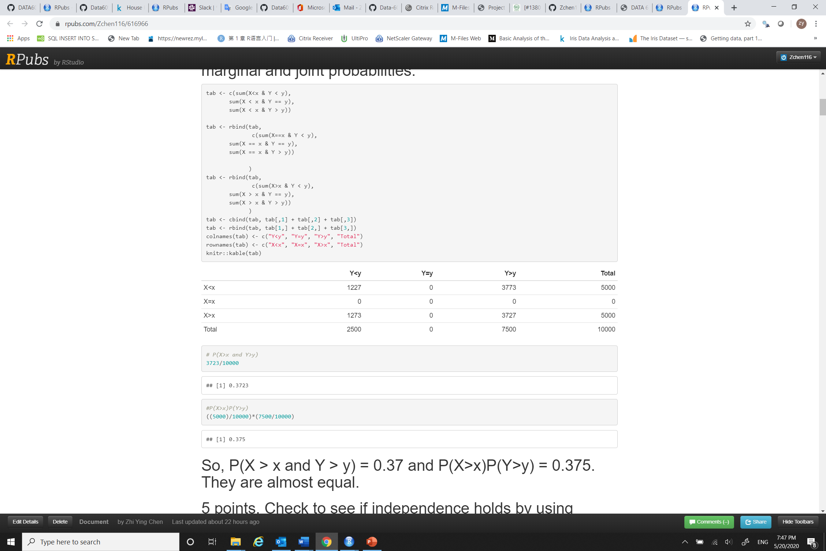
Investigate whether P(X>x and Y>y)=P(X>x)P(Y>y) by building a table and evaluating the marginal and joint probabilities
From the above marginal and conditional probability table we can see that the condition holds
P(X>x and Y>y) = # P(X>x and Y>y) 3773/10000 → 0.3773
P(X>x)P(Y>y) = ((5000)/10000)*(7500/10000)
0.375 are approximately equal.

Slide 4
5 points. Check to see if independence holds by using Fisher’s Exact Test and the Chi Square Test. What is the difference between the two? Which is most appropriate?
Fisher's exact test the null of independence of rows and columns in a contingency table with fixed marginals.
Chi-squared test tests contingency table tests and goodness-of-fit tests.
Fisher's exact test is appropriate here. Since the contingency table are fixed here in the table.

Slide 5
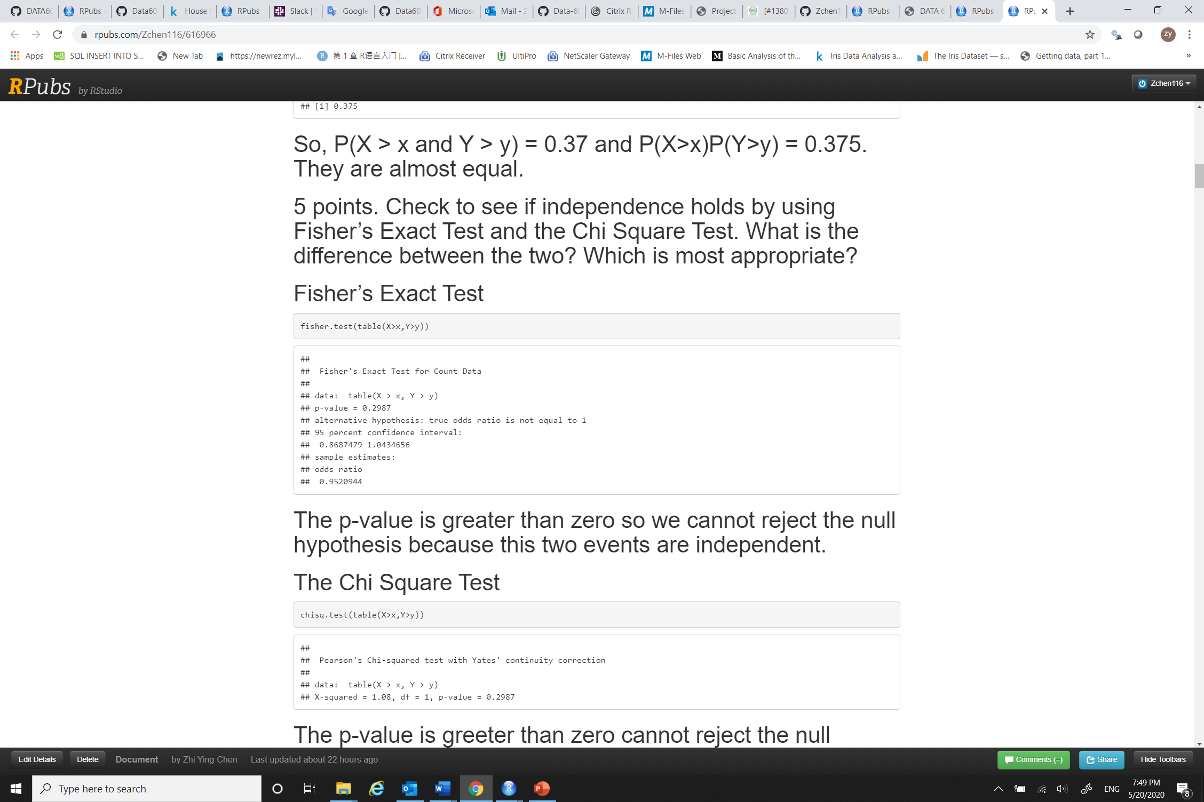
Fisher’s Exact Test
The p-value = 0.2987, which is greater than zero, so we cannot reject the null hypothesis because this two events are independent.

Slide 6
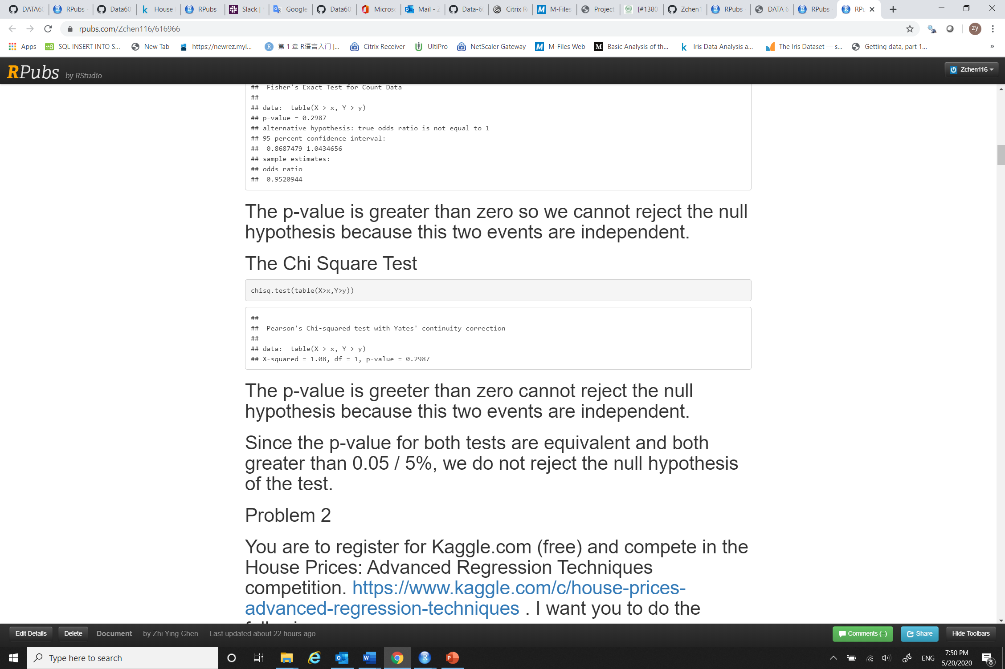
The Chi Square Test
The p-value = 0.2987, which is greeter than zero we reject the null hypothesis. Two events are independent.
Since the p-value for both tests are equivalent and both greater than 0.05 or 5%, we do not reject the null hypothesis of the test.

Slide 7
Problem 2
You are to register for Kaggle.com (free) and compete in the House Prices: Advanced Regression Techniques competition. https://www.kaggle.com/c/house-prices-advanced-regression-techniques . I want you to do the following.
Downloaded the train.csv from Kaggle.com

Slide 8
5 points. Descriptive and Inferential Statistics.
Provide univariate descriptive statistics and appropriate plots for the training data set.
Provide a scatter-plot matrix for at least two of the independent variables and the dependent variable.x
Derive a correlation matrix for any three quantitative variables in the data-set.
Discuss the meaning of your analysis. Would you be worried about family-wise error? Why or why not?

Slide 9
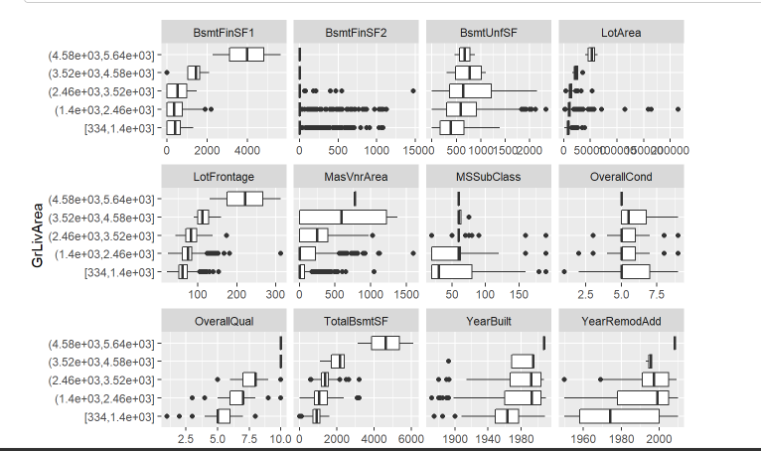
Understanding of the data distribution. I’m interested in GrLivArea and would like to build a model to predict it. Let’s plot it against all other variables

Slide 10
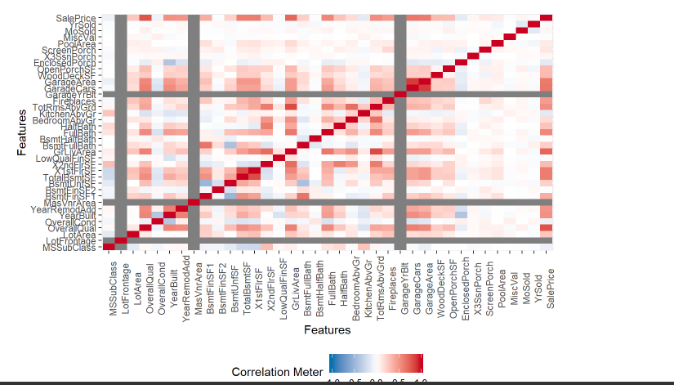
Correlation Heatmap

Slide 11
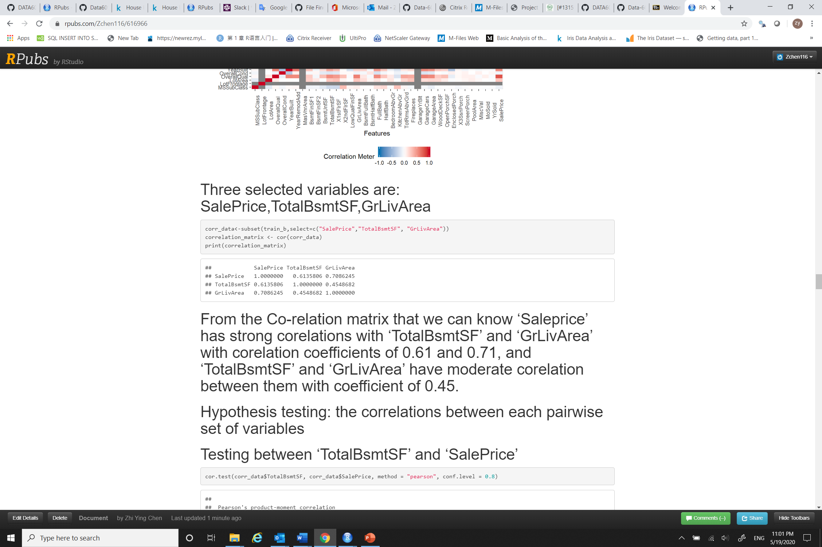

Slide 12
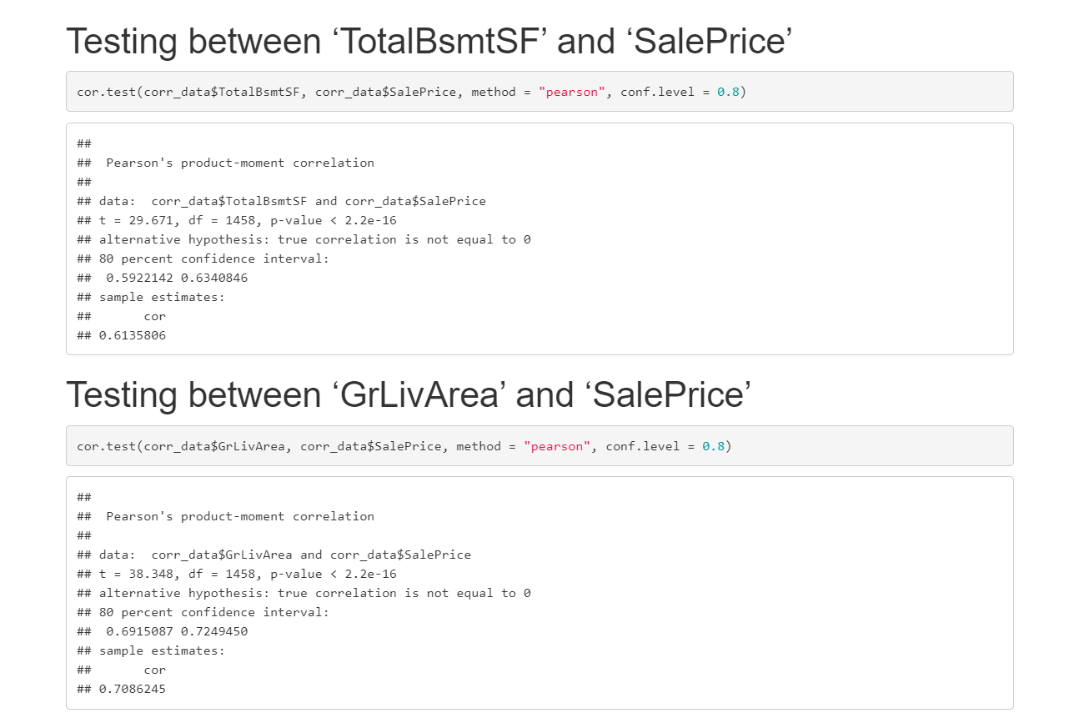
Test the hypotheses that the correlations between each pairwise set of variables is 0 and provide a 80% confidence interval.

Slide 13
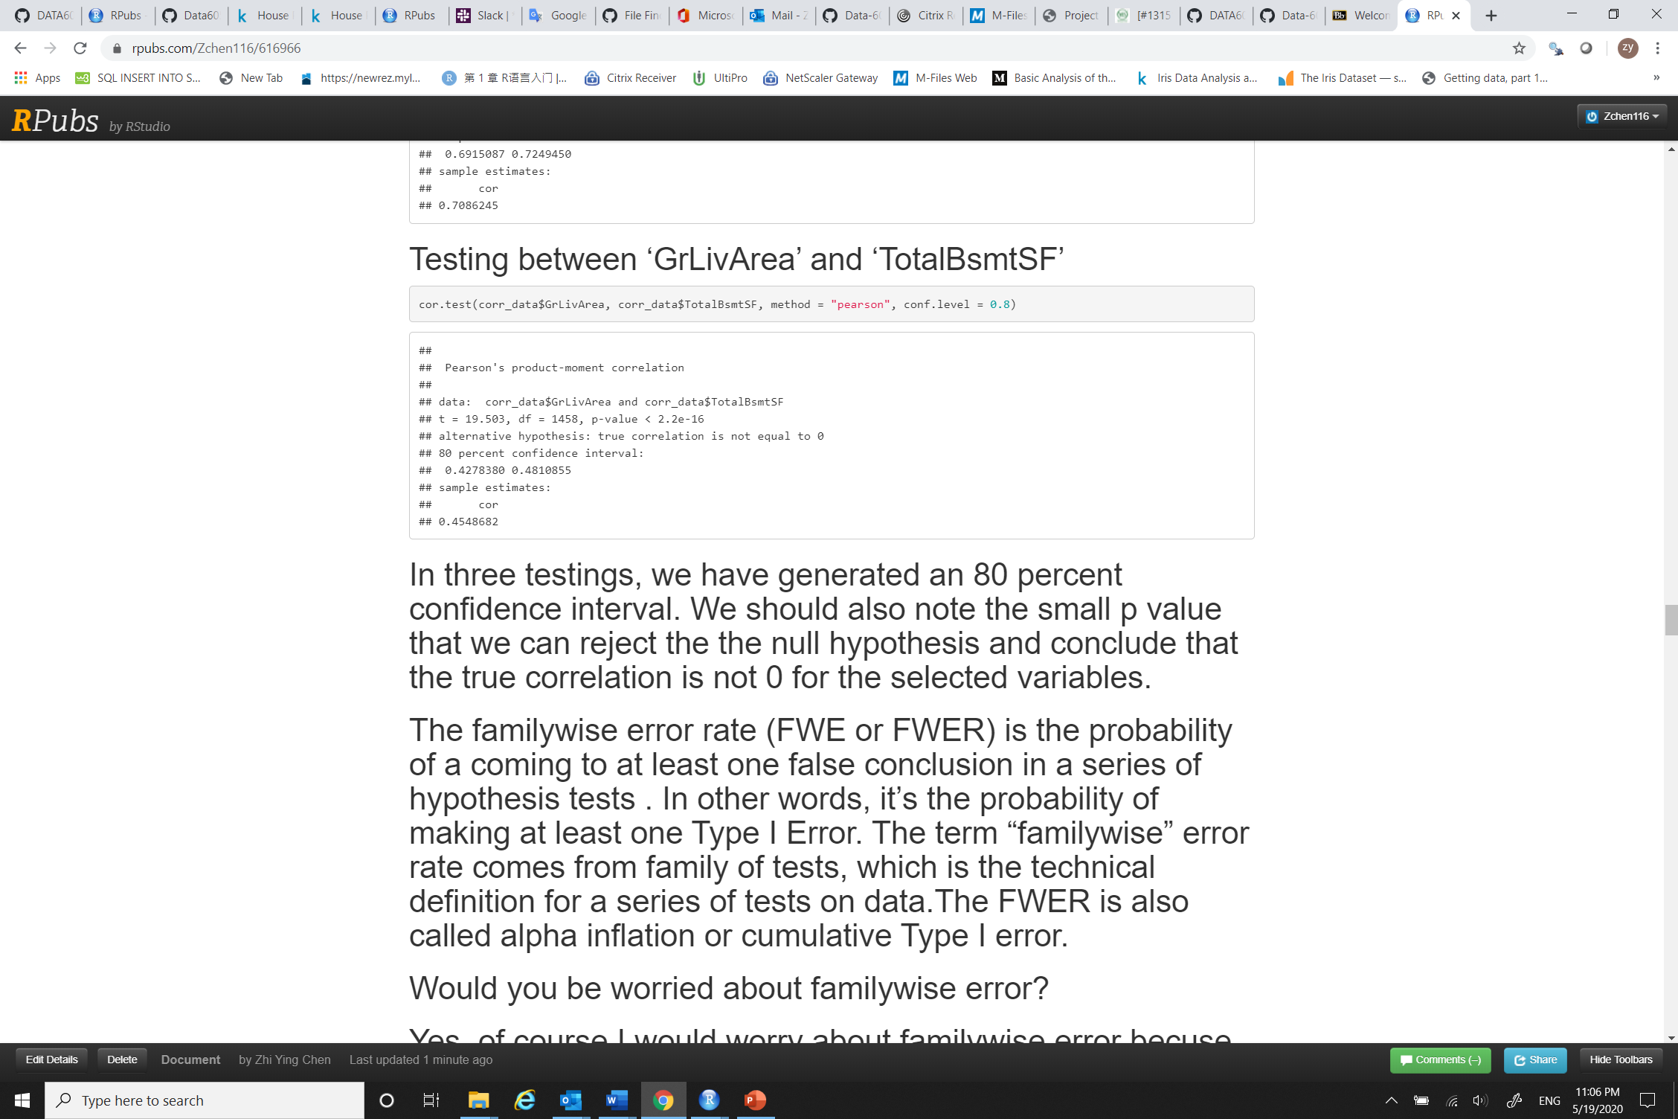
In three testing, we have generated an 80 percent confidence interval. We should also note the small p value that we can reject the null hypothesis and conclude that the true correlation is not 0 for the selected variables.

Slide 14
family wise error
The familywise error rate (FWE or FWER) is the probability of a coming to at least one false conclusion in a series of hypothesis tests . In other words, it’s the probability of making at least one Type I Error. The term “familywise” error rate comes from family of tests, which is the technical definition for a series of tests on data. The FWER is also called alpha inflation or cumulative Type I error.
Would you be worried about familywise error?
Yes, of course I would worry about familywise error because there are many variables in this dataset that might have impact on the correlation of the pairs of selected variables that are being tested here.

Slide 15
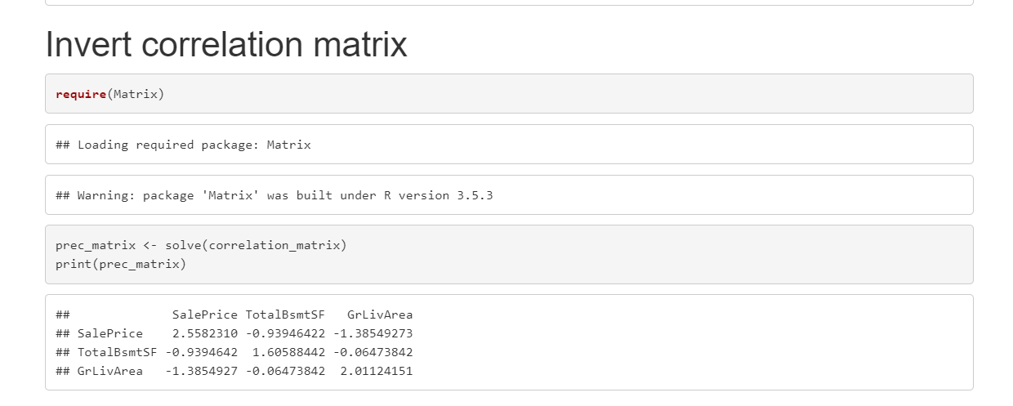
5 points. Linear Algebra and Correlation. Invert your correlation matrix from above. (This is known as the precision matrix and contains variance inflation factors on the diagonal.) Multiply the correlation matrix by the precision matrix, and then multiply the precision matrix by the correlation matrix. Conduct LU decomposition on the matrix.

Slide 16
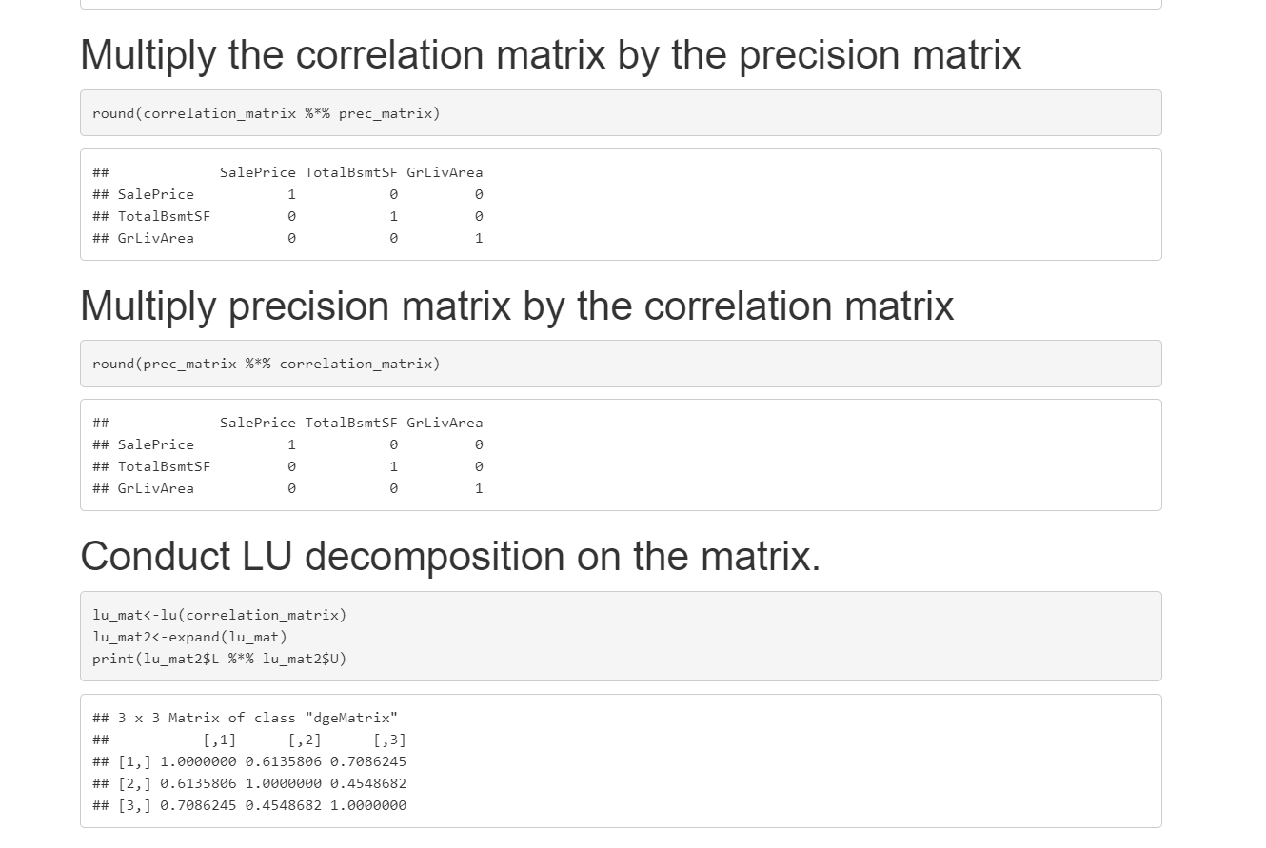

Slide 17
5 points. Calculus-Based Probability & Statistics. Many times, it makes sense to fit a closed form distribution to data. Select a variable in the Kaggle.com training dataset that is skewed to the right, shift it so that the minimum value is absolutely above zero if necessary. Then load the MASS package and run fitdistr to fit an exponential probability density function. (See https://stat.ethz.ch/R-manual/R-devel/library/MASS/html/fitdistr.html ).

Slide 18
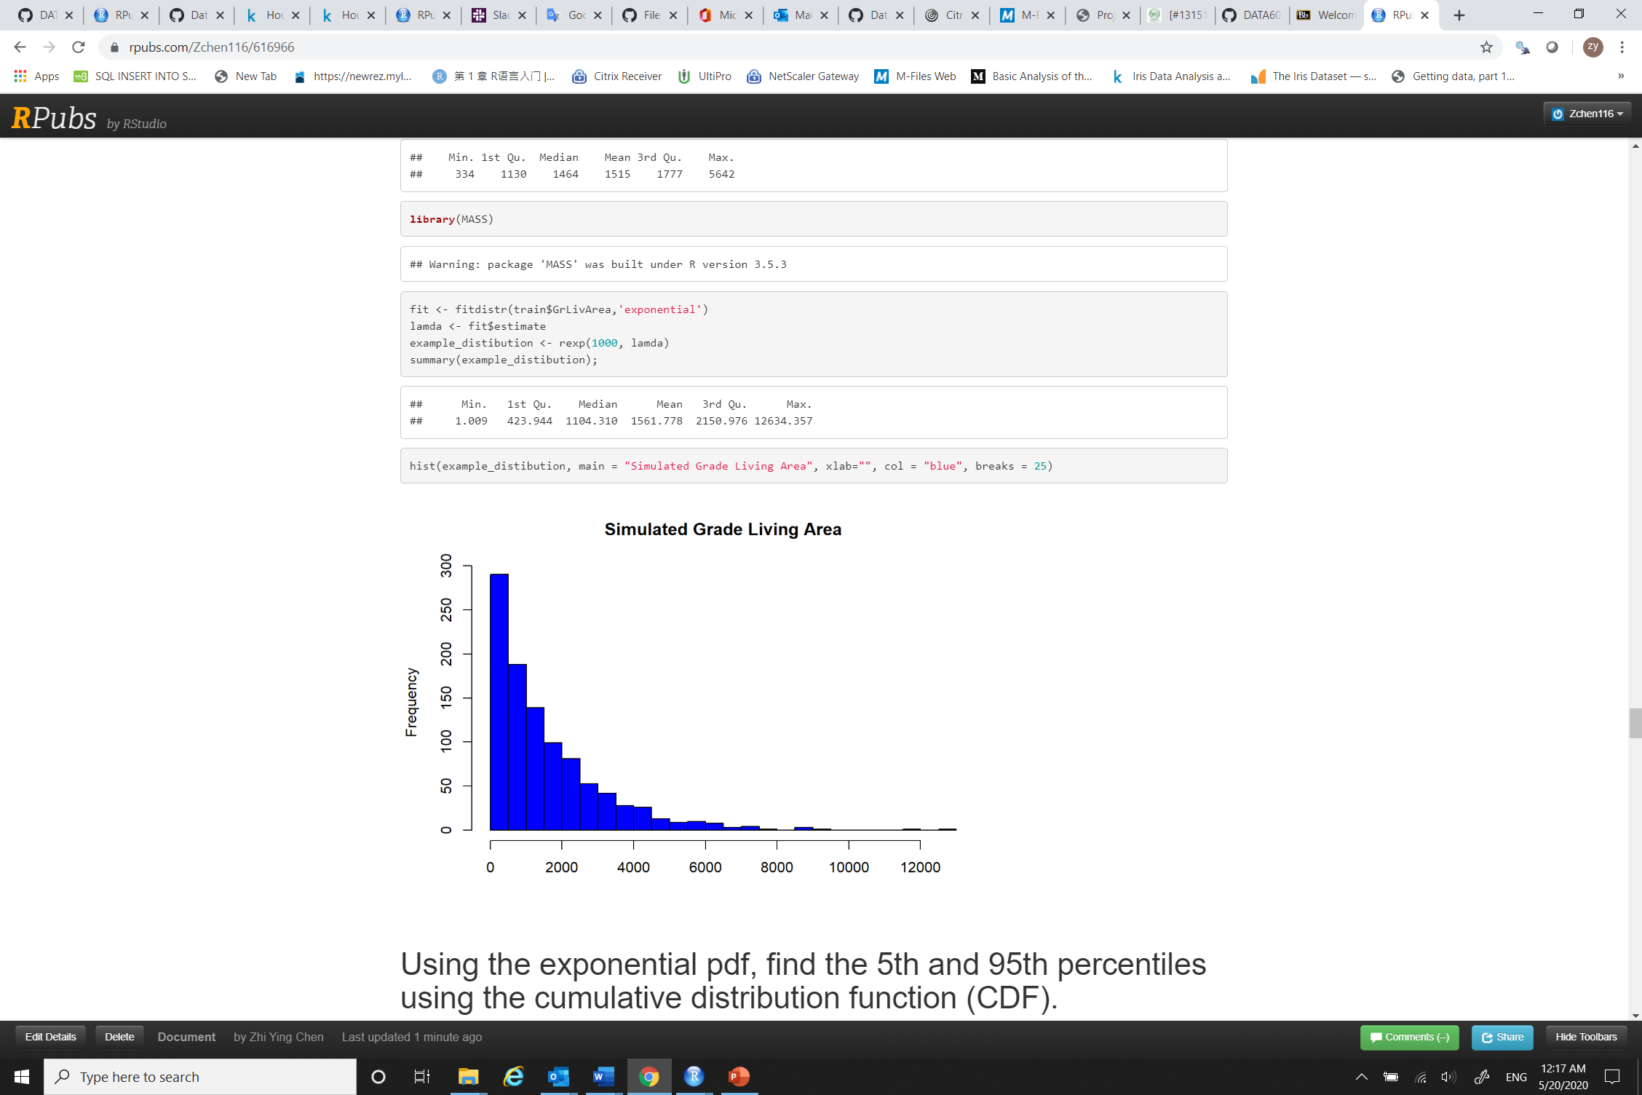
Load the Mass package and run fitdistr to fit an exponential probability density function.

Slide 19
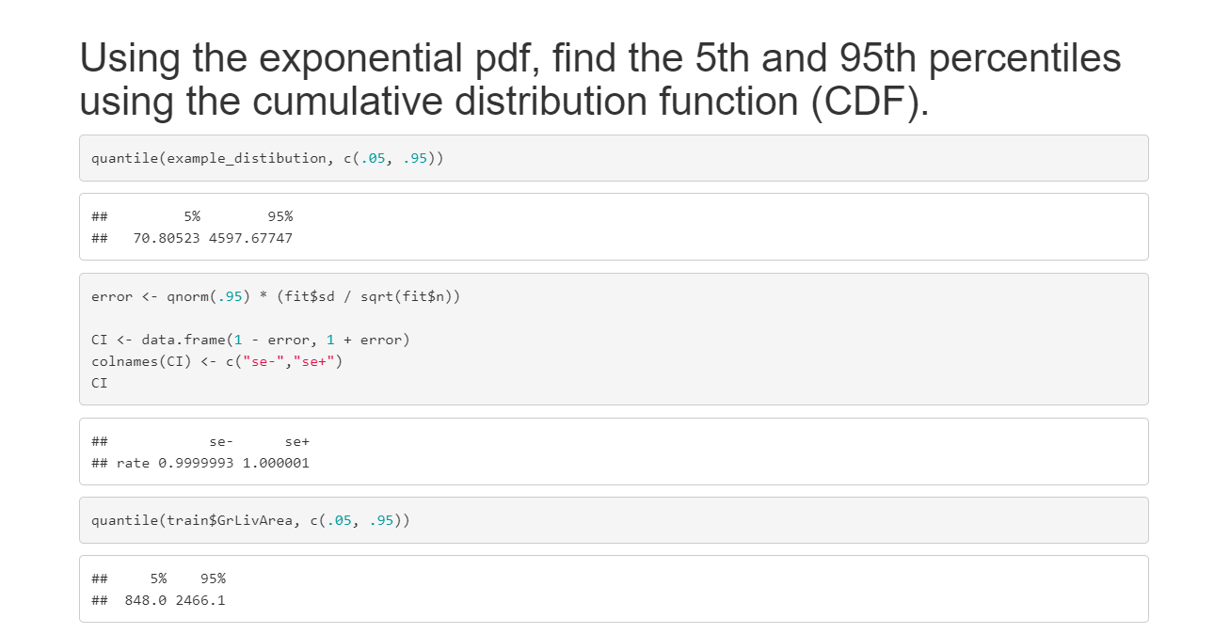
The empirical 5th and 95th percentiles (848 and 2466.1) are different than the confidence intervals

Slide 20
10 points. Modeling. Build some type of multiple regression model and submit your model to the competition board. Provide your complete model summary and results with analysis. Report your Kaggle.com user name and score.
Model Building Steps:
Read test dataset from Kaggle.com
Convert variables numeric and select completed data
Filter data
Use StepAIC method as fitted method
Do residual Analysis
Predict the output of test data using final model
Submit the submission.csv file to Kaggle.com for scoring

Slide 21
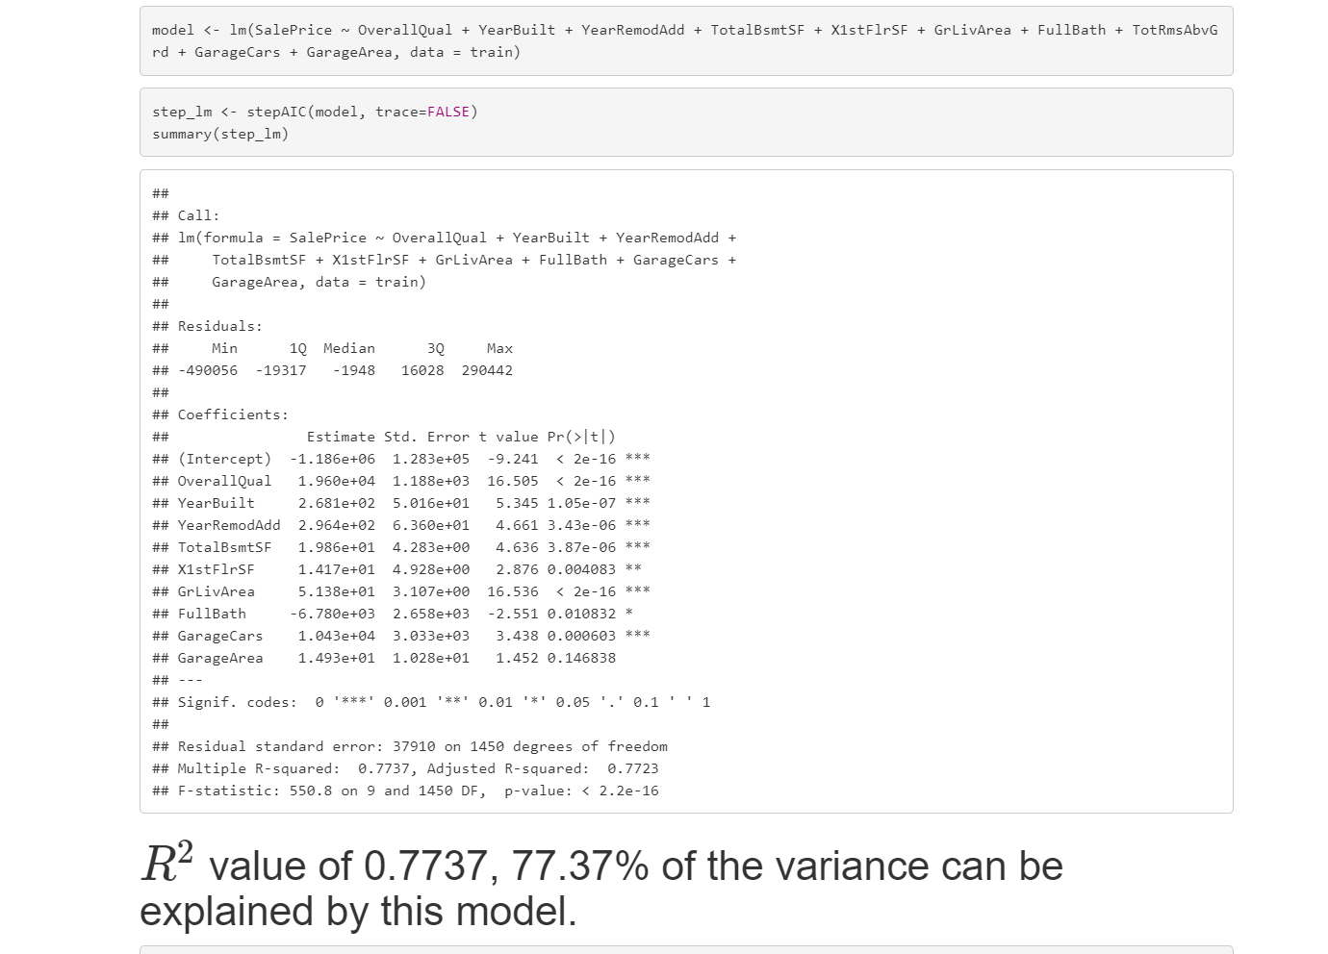
R-squared is 0.7737, which seems like a good fit

Slide 22
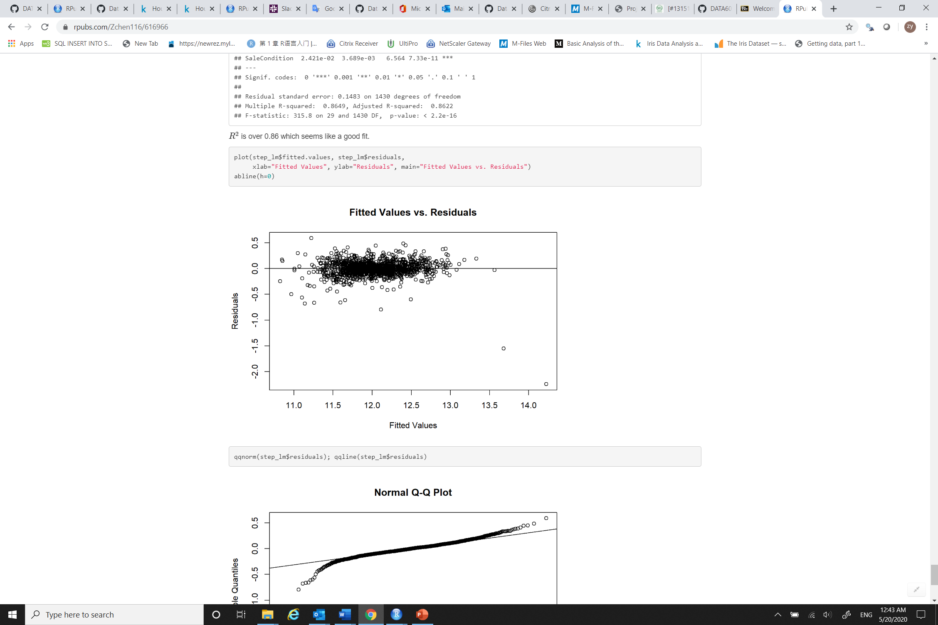
From the residuals plot we can see that the assumptions of multiple regression model are satisfied. The residuals are normally distributed.

Slide 23
Final Result
My Kaggle username is zchen116. My Score is 0.85352.

